Slide 1
Robot Project Meeting 13
07/03/2019
GAIZI Amine – IFAG ATV MC ACE CES

Slide 2
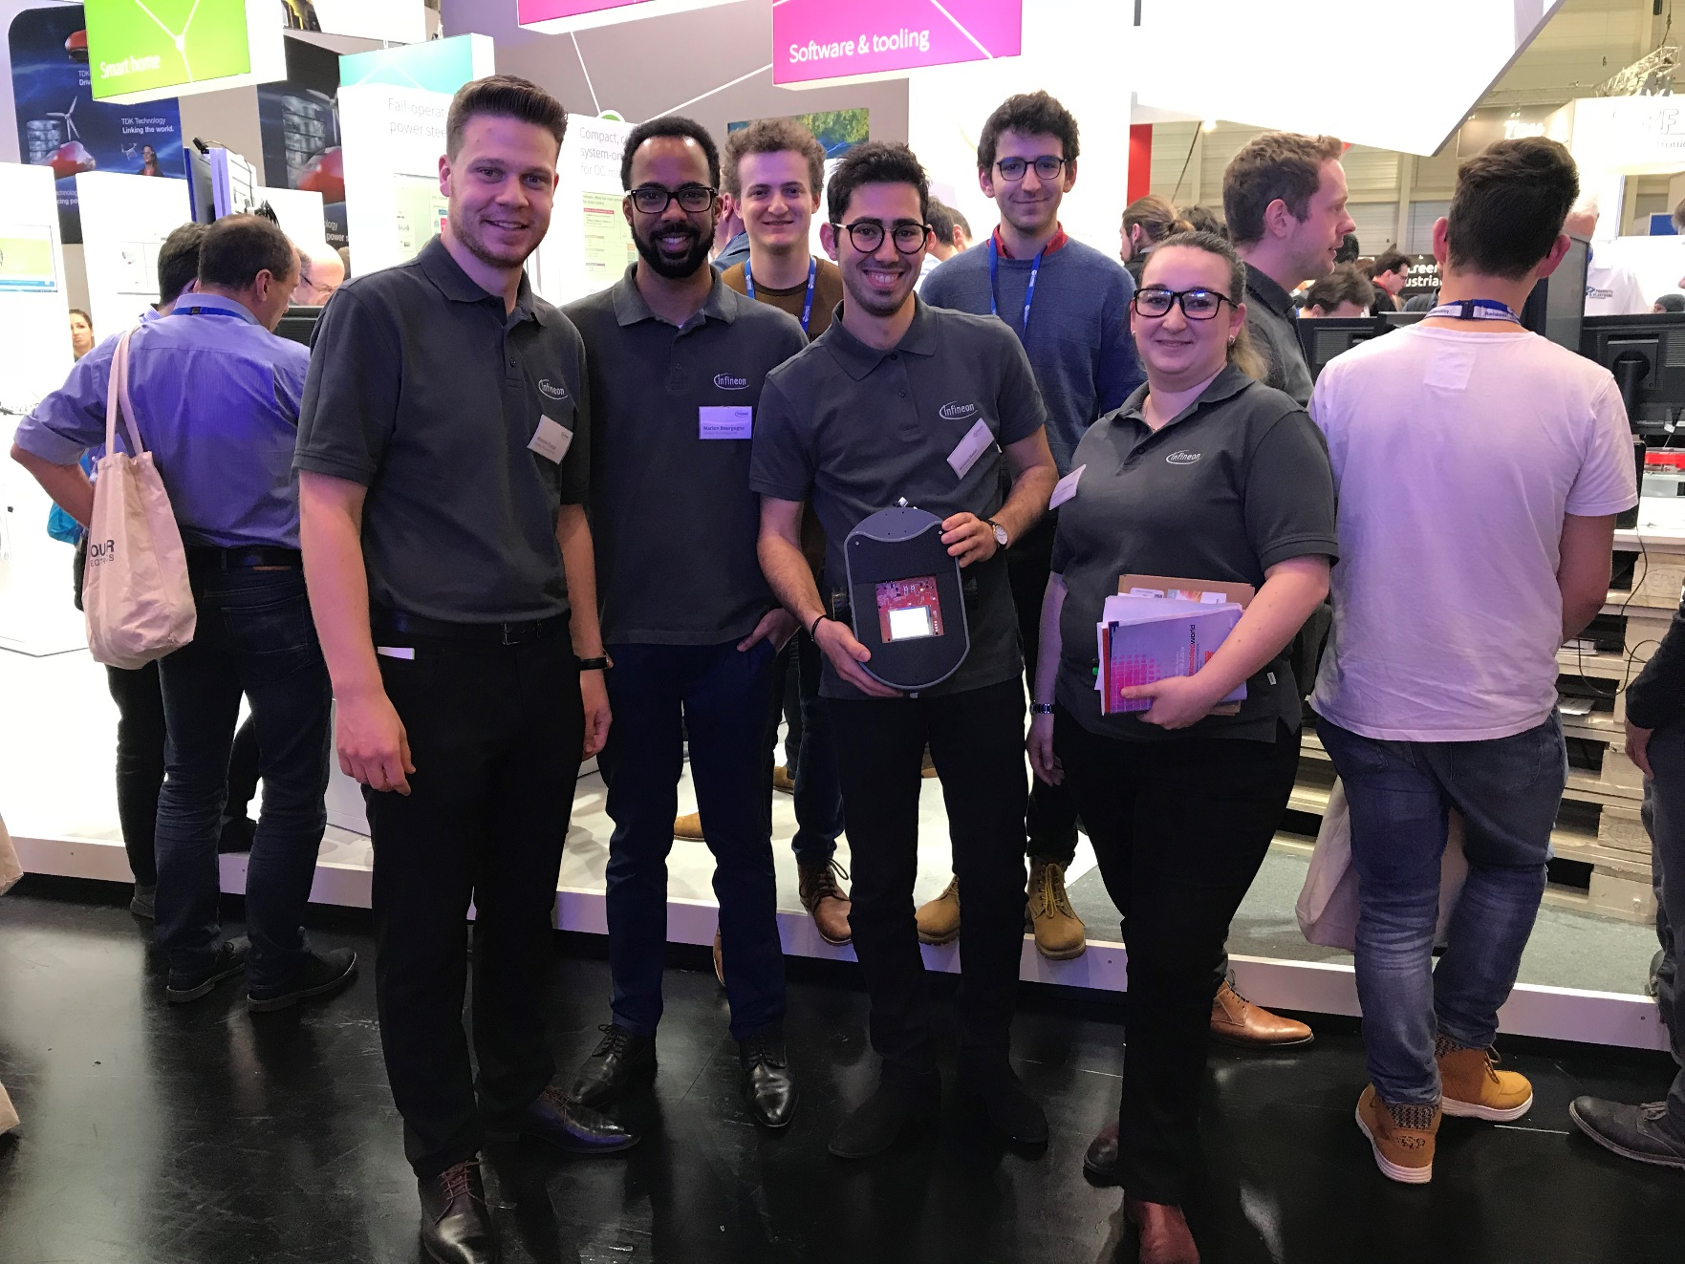

Slide 3
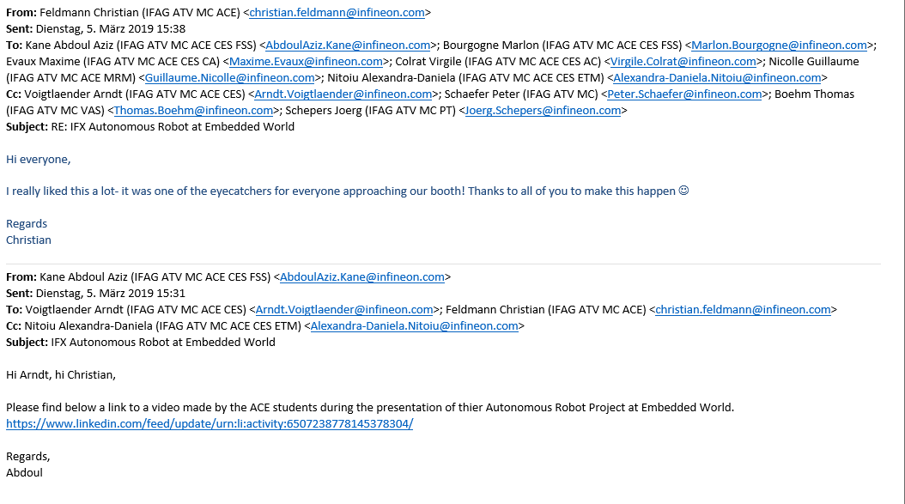
Topics to discuss
Embedded World debrief
LinkedIn Post with video of the demo, it was sent to Christian and Arndt
https://www.linkedin.com/feed/update/urn:li:ugcPost:6507238605570744320

Slide 4
Topics to discuss
Plan for the next weeks:
Mode 3: Position + Enslavement – work in progress
PCB design almost finished ?
GUI new version in C ?
Android App, patch to make the communication more stable
Keep the same hardware or try to use Infineon for Makers shields/Kits and sensors ? – Maybe this could be a idea for next year, but not very suited for AURIX

Slide 5
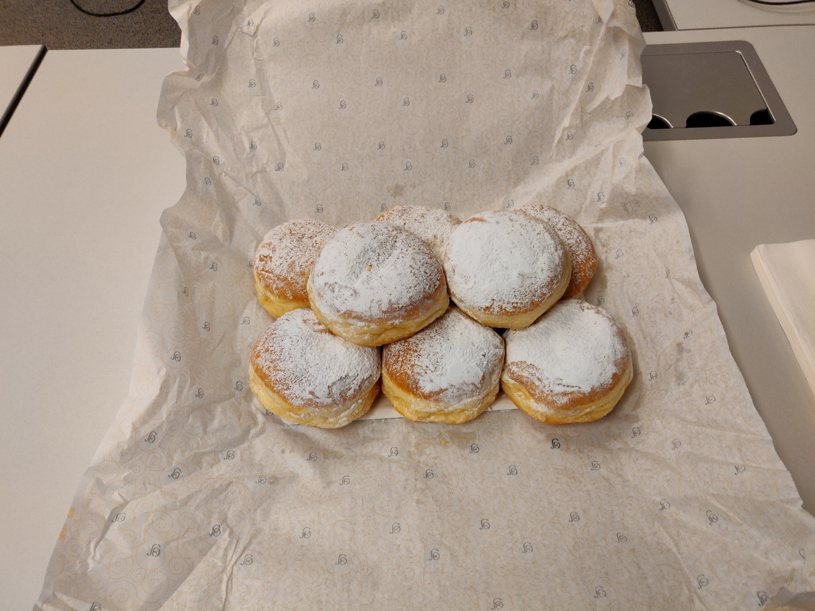
Congrats to everyone for their work ! (thanks Alex for the treat)

